Slide 1
Figures for an article
20251208
Gyeongjun LEE

Slide 2
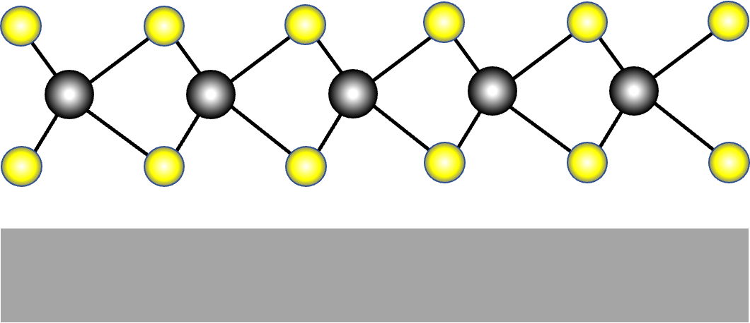
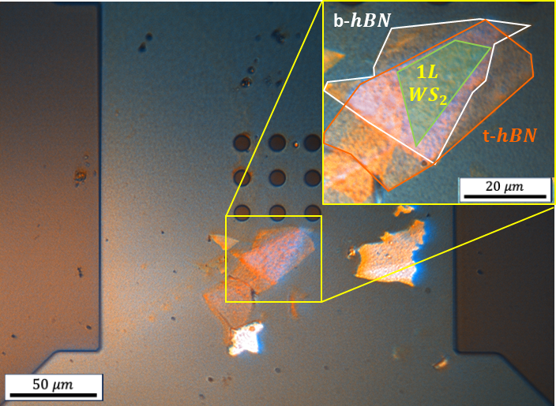
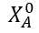
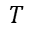
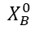

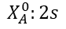
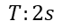
Figure 1
$$λ_{laser}=514.5nm \left(CW\right), 1uW, 20240719−20$$
(a)
(c)
T^{S}
T^{T}
$$i$$
SiC
Au
Au
Local heating
T’
XX⁻
Si
Si
37.7 meV
T^{I}
31.4 meV
(b)
X^{D}
XX
X⁰
(d)
$$X_{A}^{0}$$
$$X_{B}^{0}$$
$$T$$
$$X_{A}^{0}:2s$$
$$T:2s$$
Chip 3-3, PLE 470-614nm, 4uW, 20241129

Slide 3
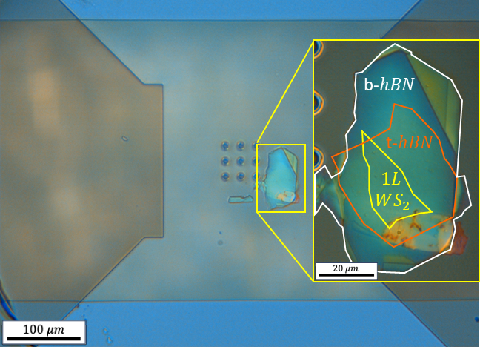
Figure 1
$$λ_{laser}=514.5nm \left(CW\right), 1uW, 20240719−20$$
PL
(a)
(c)
T^{S}
T^{T}
$$i$$
SiC
Au
Au
Local heating
T’
XX⁻
Si
Si
37.7 meV
T^{I}
31.4 meV
(b)
X^{D}
XX
X⁰
SiC
(d)
$$X_{A}^{0}$$
Si
$$X_{B}^{0}$$
$$T$$
$$X_{A}^{0}:2s$$
$$T:2s$$
Chip 3-3, PLE 470-614nm, 4uW, 20241129
Notes:
what you want to do -> defect. current flowing image -> joule heating. Same sample image (hbn, ws2)

Slide 4
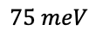
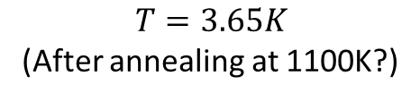
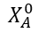
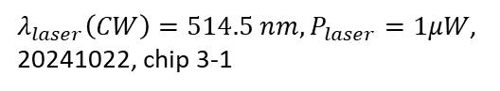
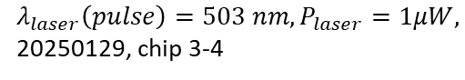
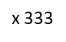
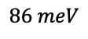
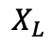
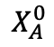
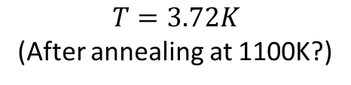
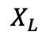
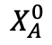
Figure 2
$$X_{A}^{0}$$
$$X_{A}^{0}$$
$λ_{laser}(pulse)=505 nm , P_{laser}=1μW$, chip 4-2, 20250917
(a)
(b)
x 333
$$X_{L}$$
$$T=3.65K$$
(After annealing at 1100K?)
x 250
$$75 meV$$
x 111
$λ_{laser}\left(CW\right)=514.5 nm, P_{laser}=1μW$, 20241022, chip 3-1
x 91
x 71
$$X_{A}^{0}$$
x 56
x 33
x 20
(c)
$$X_{L}$$
x 10
$$T=3.72K$$
(After annealing at 1100K?)
x 4
$$86 meV$$
x 1
$λ_{laser}\left(pulse\right)=503 nm, P_{laser}=1μW,$ 20250129, chip 3-4
x 2
$$X_{A}^{0}$$
Notes:
Calibration of tempeature instead of schematic, PL spectrum depending on the temperature.
두개 3-1. 3-4

Slide 5
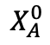
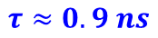
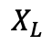
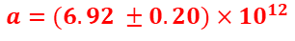
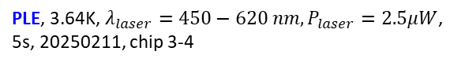
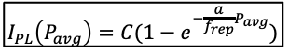
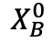
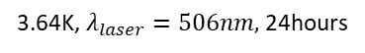
Figure 3
20250207, 503nm (pulsed laser), 3.68K
PLE, 3.64K, $λ_{laser}=450−620 nm, P_{laser}=2.5μW$, 5s, 20250211, chip 3-4
$$I_{PL}\left(P_{avg}\right)=C(1−e^{−\frac{a}{f_{rep}}P_{avg}})$$
(a)
(b)
$$X_{L}$$
$$X_{A}^{0}$$
$$X_{B}^{0}$$
$$a=(6.92 ±0.20)×{10}^{12}$$
(c)
(d)
3.64K, $λ_{laser}=506nm,$ 24hours
$$τ≈0.9 ns$$
506 nm, 39MHz, 3.68K, 2.5uW 20250210,
20250211, 3.64K, 24hours, 78MHz

Slide 6
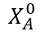
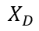
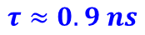
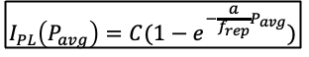
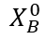
Figure 3
PLE, 3.64K, $λ_{laser}=450−620 nm, P_{laser}=2.5μW$, 5s, 20250211, chip 3-4
$$I_{PL}\left(P_{avg}\right)=C(1−e^{−\frac{a}{f_{rep}}P_{avg}})$$
(a)
(b)
$$X_{D}$$
$$X_{A}^{0}$$
$$X_{B}^{0}$$
$$a=(6.92 ±0.20)×{10}^{12}$$
(c)
(d)
3.64K, $λ_{laser}=506nm,$ 24hours
$$τ≈0.9 ns$$

Slide 7
Figure 4
WS2 on SiC, secondary vacuum at RT, temperature calibrated at RT in vacuum, with a green laser -> raman and PL spectrum with the same laer -> PL(600gr) raman (1800gr), 1 column temperature of the sample, PL peak postion, Ratio between stokes and anti stokes of both of two peaks, last column temperature from black body..
Very close to center of the membrane
Raman peak ratio
Black body radiation
1000K
T

Slide 8
First, the method.
Figure description.

Slide 9
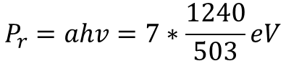
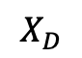
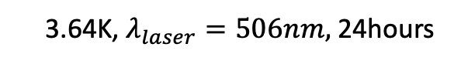
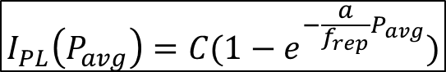
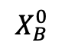
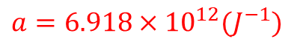
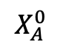
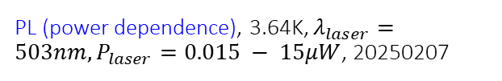
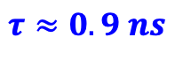
Figure 3
PL (power dependence), 3.64K, $λ_{laser}=503nm, P_{laser}=0.015 − 15μW$, 20250207
(a)
2.041 eV
2.439 eV
(b)
$$I_{PL}\left(P_{avg}\right)=C(1−e^{−\frac{a}{f_{rep}}P_{avg}})$$
$$X_{D}$$
$$X_{A}^{0}$$
$$X_{B}^{0}$$
$a=6.918×{10}^{12}(J^{−1})$
$$P_{r}=ahv=7∗\frac{1240}{503}eV$$
(c)
(d)
3.64K, $λ_{laser}=506nm,$ 24hours
$$τ≈0.9 ns$$
Notes:
Error of the fit

Slide 11
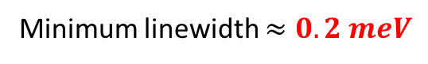
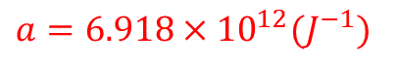
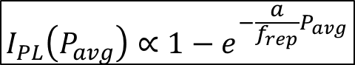
Power dependent measure
PL (power dependence), 3.64K, $λ_{laser}=503nm, P_{laser}=0.015 − 15μW$, 20250207
$$I_{PL}\left(P_{avg}\right)∝1−e^{−\frac{a}{f_{rep}}P_{avg}}$$
$a=6.918×{10}^{12}(J^{−1})$
Minimum linewidth $≈0.2 meV$

Slide 12
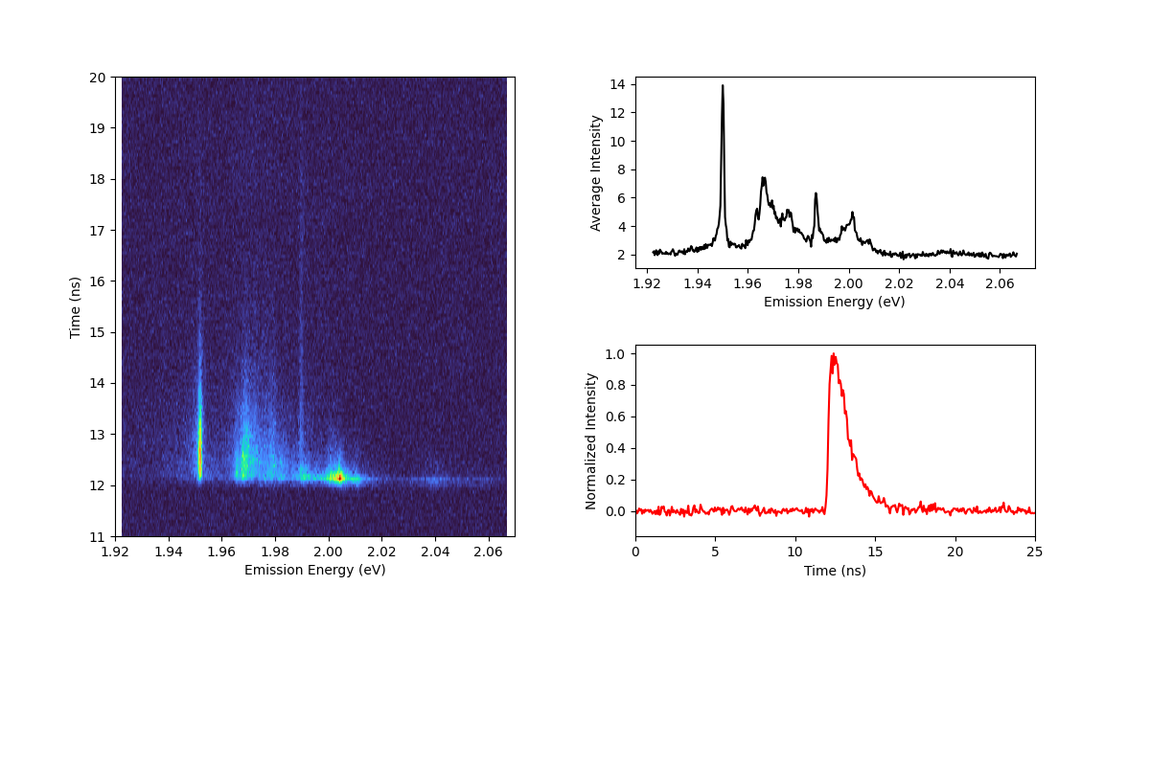
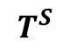
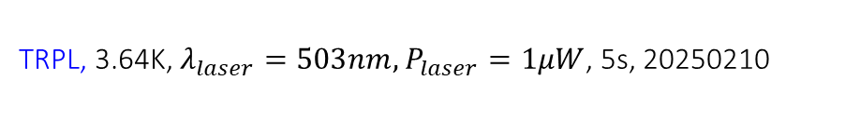


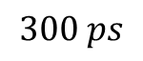
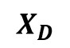






TRPL measurements
TRPL, 3.64K, $λ_{laser}=503nm, P_{laser}=1μW$, 5s, 20250210
$$X_{D}$$
3.64K, $λ_{laser}=503$nm, $P_{laser}=1μW$, 5s
$$T^{S}$$
$$T^{T}$$
$$X_{A}^{0}$$
$$300 ps$$
$$τ≈0.9 ns$$
$$X_{D}$$
$$T^{S}$$
$$T^{T}$$
$$X_{A}^{0}$$

Slide 13




G2 measurements
# chip 3-4
G2 measurements (Pulsed laser), 3.64K, $λ_{laser}=506nm,$ 24hours, 20250209
Hanbury-Brown Twiss Interferometer
(c)
(a)
3.64K, $λ_{laser}=506nm,$ 24hours
Second order correlation function
(b)
$$g^{\left(2\right)}\left(τ\right)=\frac{\left\langle I(t)\right\rangle \left\langle I(t+τ)\right\rangle }{{\left\langle I\left(t\right)\right\rangle }^{2}}$$

Slide 16


Figure 2
$$λ_{laser}=506 nm, P_{laser}=1μW$$
$$λ_{laser}(pulse laser)=505 nm, P_{laser}=1μW$$
(a)
(b)
$$X_{D}$$
$$X_{A}^{0}$$
Notes:
Calibration of tempeature instead of schematic, PL spectrum depending on the temperature.
두개 3-1. 3-4

Slide 17





Sample image (hbn-encapsulated)
PL
(a)
Side view
(c)
Encapsulated$WS_{2}$
Au
Au
Si
SiC Membrane
Si
(b)
Top view (x10, 50)
Notes:
what you want to do -> defect. current flowing image -> joule heating. Same sample image (hbn, ws2)

Slide 18










$$50 μm$$
$$100 μm$$
$$20 μm$$
b-$hBN$
$$1L$$
$$WS_{2}$$
t-$hBN$

Slide 19



Slide 20




Slide 21








$$100 μm$$
$$20 μm$$
b-$hBN$
t-$hBN$
$$1L$$
$$WS_{2}$$

Slide 22



Sample image (non-encapsulated)
Side view
(c)
Top view (x100)
(a)
WS₂
SiC Membrane
Si
(b)
Top view (x5)
$$10 μm$$

Slide 23




$1L$
$$WS_{2}$$
$$20 μm$$

Slide 24


Sample image (non-encapsulated)
Side view
(a)
Top view (x100)
WS₂
(c)
SiC Membrane
Si
(b)
Top view (x5)
Annealing at 1100K
$$10 μm$$
As-exfoliated

Slide 25



PLE measurements
PLE, 3.64K, $λ_{laser}=450−620 nm, P_{laser}=1μW$, 5s, 20250211
2.041 eV
2.439 eV
$$X_{D}$$
$$X_{A}^{0}$$
$$X_{B}^{0}$$

Slide 27
PL spectrum
# chip 2-1
T^{T}
3.66 K, cw laser 514,5 nm, 1uW, 30s
T^{S}
T’
XX⁻
phonon assisted
recombination
of dark trions
37.7 meV
T^{I}
31.4 meV
X^{D}
XX
X⁰

Slide 28
PL spectrum
# chip 2-1
T^{S}
T^{T}
3.66 K, cw laser 514,5 nm, 1uW, 30s
T’
XX⁻
phonon assisted
recombination
of dark trions
37.7 meV
T^{I}
31.4 meV
X^{D}
X⁰
XX

